Slide 1
Some basics

Slide 2
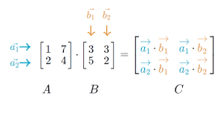
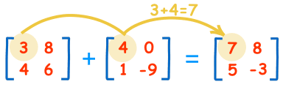

Slide 3
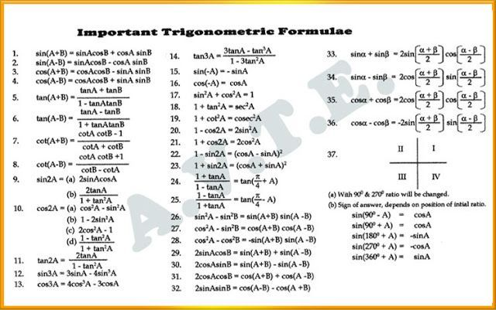

Slide 4
Program to draw a circle
#include<graphics.h>
#include<conio.h>
main()
{
int gd = DETECT, gm;
initgraph(&gd, &gm, "C:\\TC\\BGI");
circle(100, 100, 50);
getch();
closegraph();
return 0;
}

Slide 5
Module 2
Transformation

Slide 6
Contents
Object representations & Transformations- 2D & 3D
Affine transformations- Translation, scaling, rotation, reflection, shearing;
multiple transformations
Plane Geometric Projections- Parallel and Perspective Viewing

Slide 8
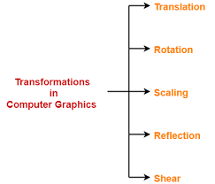

Slide 9
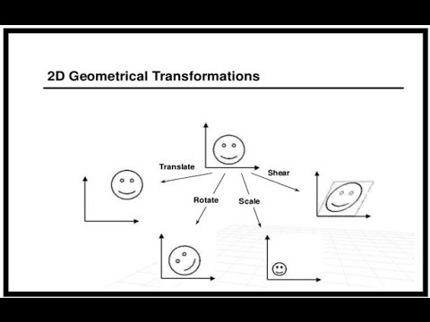

Slide 10
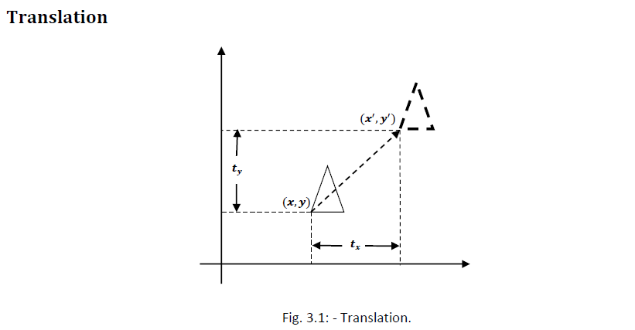

Slide 11
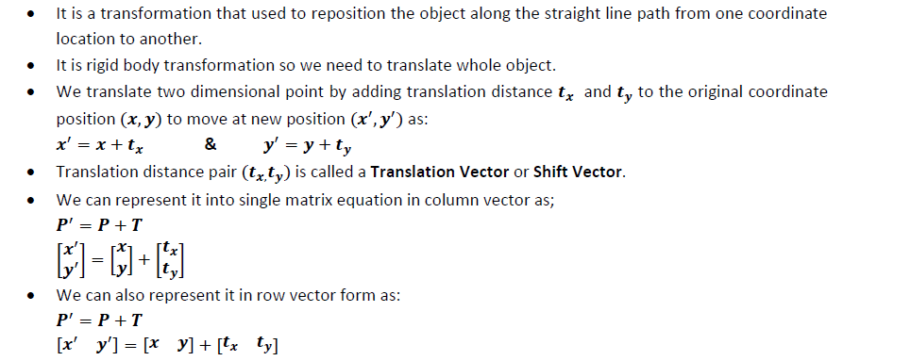

Slide 12
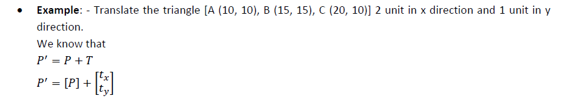
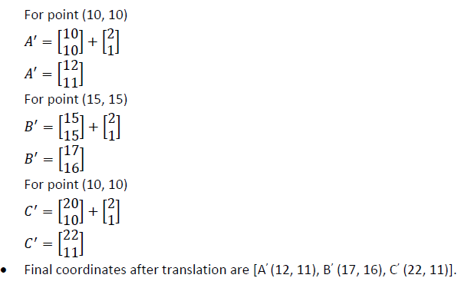

Slide 13
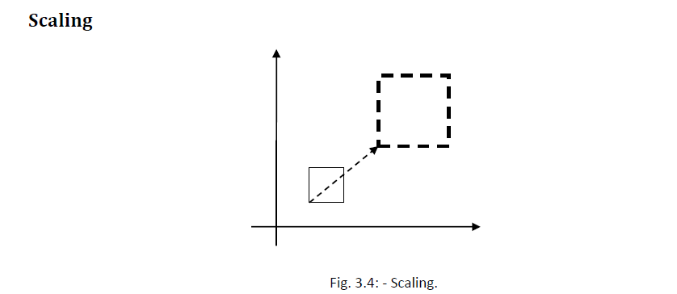

Slide 14
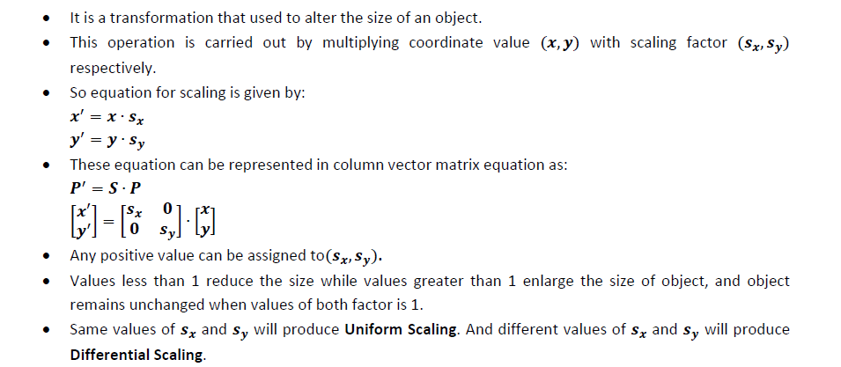

Slide 15
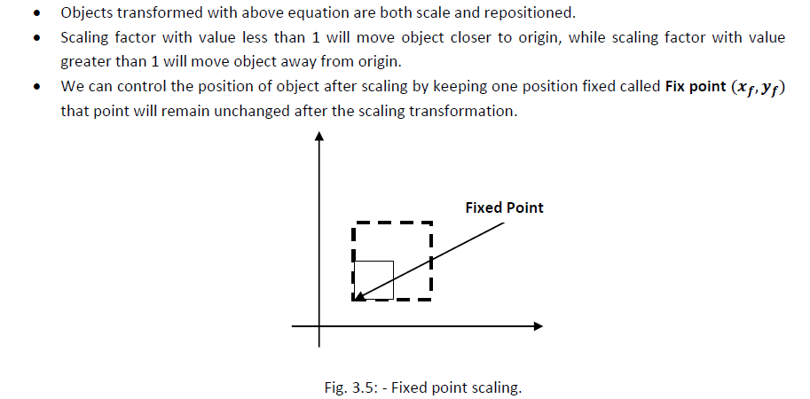

Slide 16
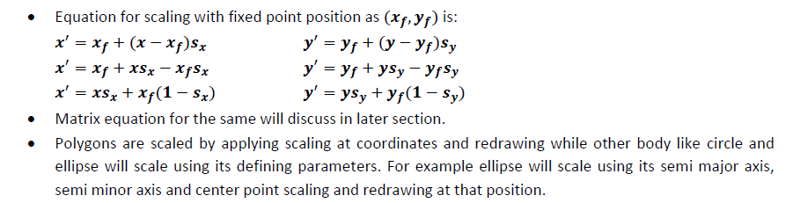

Slide 17
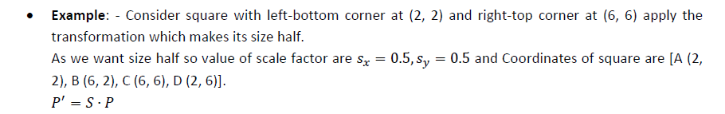
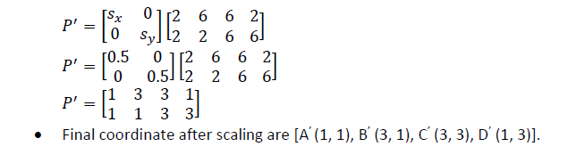

Slide 18
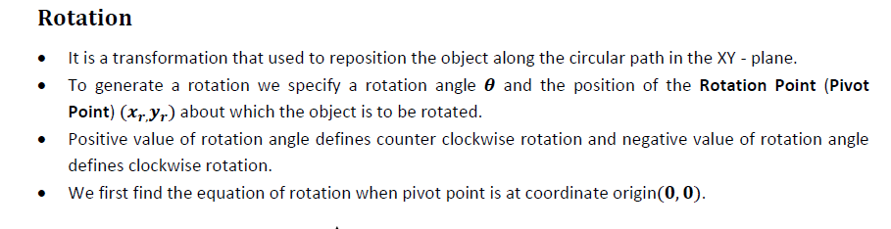
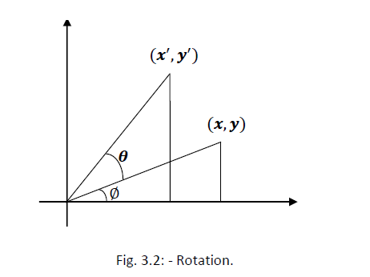

Slide 19
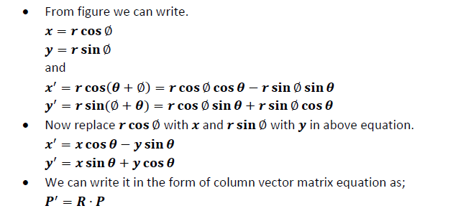

Slide 20
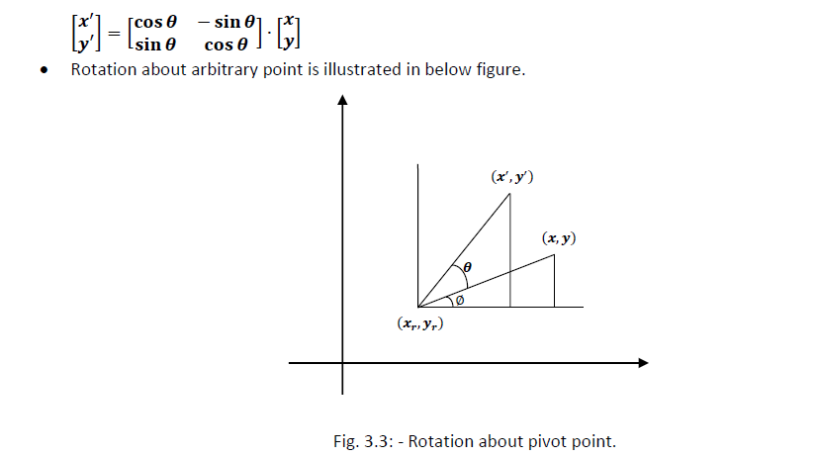

Slide 21
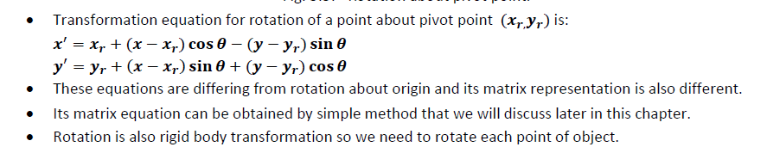

Slide 22
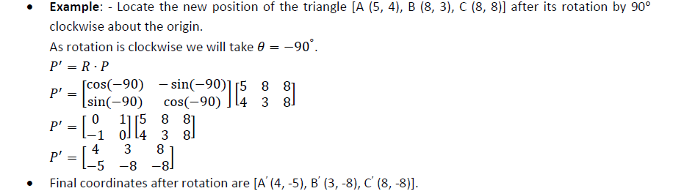

Slide 23
Functions of graphics.h
arc bar bar3d circle cleardevice closegraph drawpoly ellipse fillellipse fillpoly floodfill getarccords getbkcolor getcolor getdrivername getimage
getmaxcolor getmaxx getmaxy getpixel getx gety graphdefaults grapherrormsg imagesize line lineto linerel moveto moverel outtext outtextxy pieslice putimage putpixel rectangle
sector setbkcolor setcolor setfillstyle setlinestyle settextstyle setviewport textheight textwidth

Slide 25
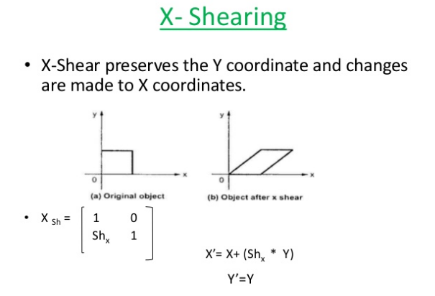

Slide 26
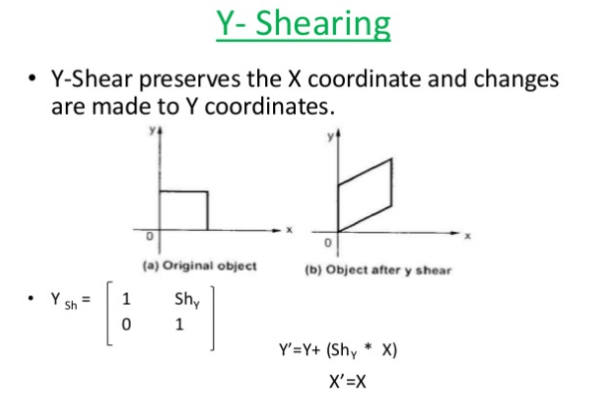

Slide 27
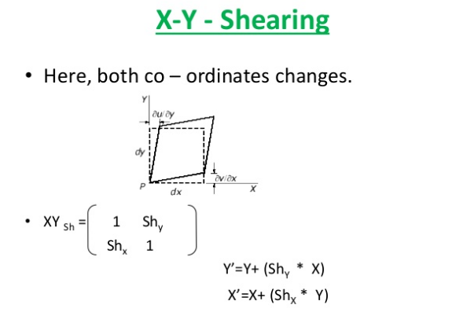

Slide 28
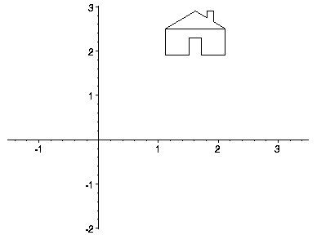
· Transformations are a fundamental part of the computer graphics. Transformations are the movement of the object in Cartesian plane .

Slide 29
There are two types of transformation in computer graphics.
1) 2D transformation
2) 3D transformation
Types of 2D and 3D transformation
1) Translation
2) Rotation
3) Scaling
4) Shearing
5) Mirror reflection

Slide 30

· Transformation are
used to
position
objects , to shape object , to change
viewing positions , and something is viewed.
even how
In simple words transformation is used for
1) Modeling
2) viewing

Slide 31
When the transformation takes place on a 2D plane .it is called 2D transformation.
2D means two dimensional (x-axis and Y-axis)
Object Transformation in 2D
Alter the coordinates descriptions an object
Translation , rotation , scaling , shearing,
reflection.
Coordinate system unchanged Coordinate transformation in 2D
Produce a different coordinate system

Slide 32
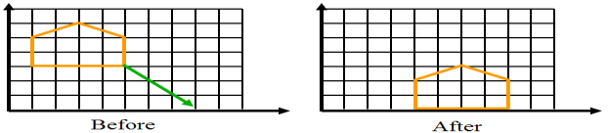
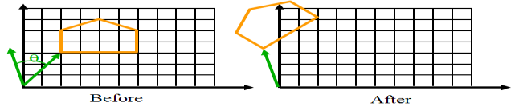
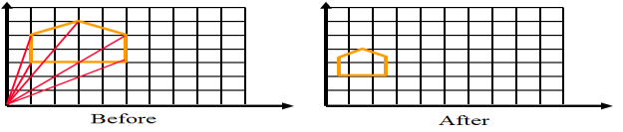
· Translation:-
Rotation:-
· Scaling:-

Slide 33
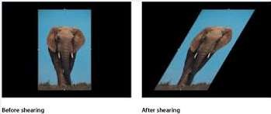
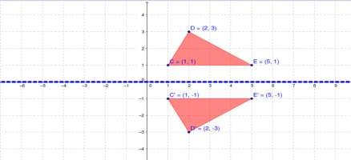
Shearing:-
Reflection

Slide 34
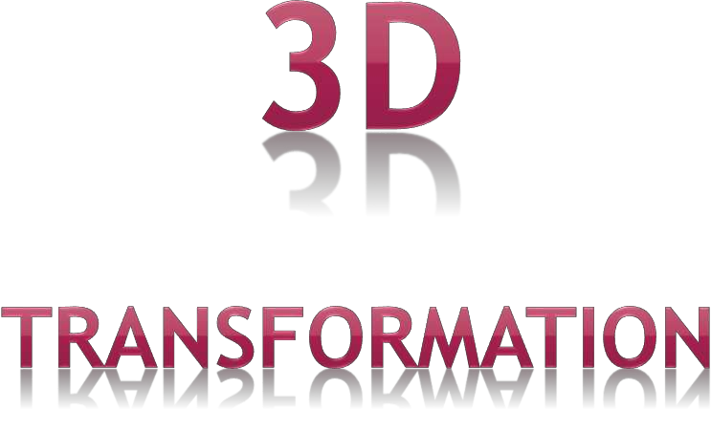

Slide 35


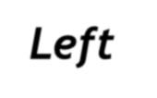



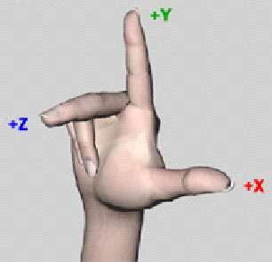
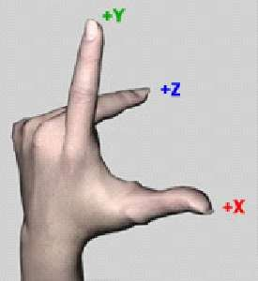
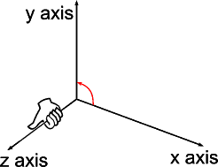
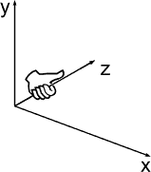
· Right Hand
coordinate system:
Left Hand
coordinate system

Slide 36
⎡ x⎤
Point We will consider points as column Vectors . Thus, a typical point with coordinates (x, y, z) is represented as:
⎢ _{y}⎥
⎢ ⎥
⎢⎣ z ⎥⎦
3D Point Homogenous Coordinate
A 3D point P is represented in homogeneous
coordinates by a 4-dim.
⎡ x ⎤
⎢ _{y}⎥
P = ⎢
⎥
The main advantage:- it is easier to compose translation and rotation
⎢ z ⎥
⎢₁ ⎥
⎣ ⎦

Slide 37
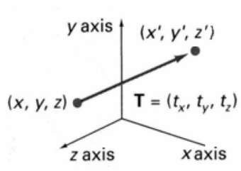


· Moving of object is called t r a n s l a t I o n
In 3 dimensional homogeneous coordinate representation , a point is transformed from position P = ( x, y , z) to P’=( x’, y’, z’)
This can be written as:- Using P’ = T . P
⎡ x′⎤
⎡1 0 0
1 0
0 1
0 0
t_{x} ⎤ ⎡ x⎤
⎢ _{y′}⎥ ⎢₀
_{t} ⎥ ⎢ _{y}⎥
⎢ ⎥ ₌ ⎢
^{y} ⎥ ⋅ ⎢ ⎥
⎢ z′⎥ ⎢0
t_{z} ⎥ ⎢ z ⎥
⎢ ₁ ⎥ ⎢₀
₁ ⎥ ⎢₁⎥
⎣ ⎦ ⎣
⎦ ⎣ ⎦

Slide 38
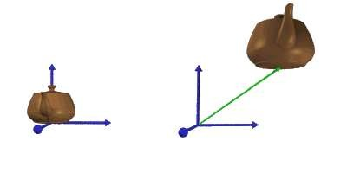
x’=x+ t_{x} , y’=y+ t_{y} , z’=z+ t_{z}
· The matrix representation is equivalent to the three equation.
Where parameter t_{x ,} t_{y ,} t_{z} are specifying translation distance for the coordinate direction x , y , z are assigned any real value.
Translate an object by translating each vertex in the object.

Slide 39



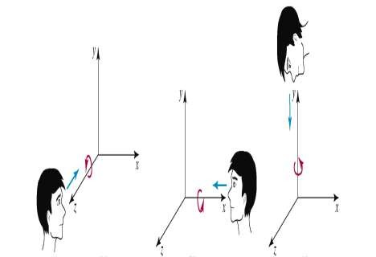
where an object is to be rotated about an axis that is parallel to one of the coordinate axis, we can obtain the desired rotation with the following transformation sequence.
Coordinate axis rotation
Z- axis Rotation(Roll) Y-axis Rotation(Yaw) X-axis Rotation(Pitch)

Slide 40


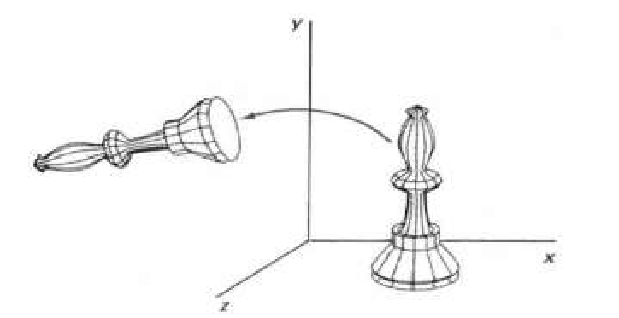
Z-axis rotation is same as the origin about in 2D for which we have the derived matrices already.
x’ = x cosθ – y sinθ y’ = x sinθ – y cosθ z’ = z
⎡ x'⎤ ⎡cosθ − sin θ 0
cosθ 0
0 1
0 0
0⎤ ⎡ x⎤
⎢ _{y'}⎥
⎢sin θ
₀⎥ ⎢ _{y}⎥
⎢ ⎥ ₌ ⎢
⎥ ⋅ ⎢ ⎥
⎢ z'⎥ ⎢
0
0
0⎥ ⎢ z ⎥
⎢ ₁ ⎥ ⎢
₁⎥ ⎢₁⎥
⎣ ⎦ ⎣
⎦ ⎣ ⎦

Slide 41
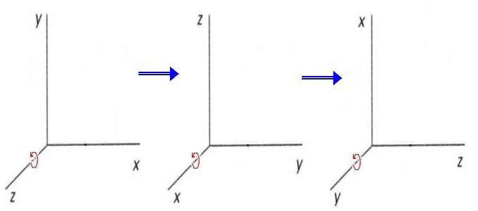
· Obtain rotations around other axes cyclic permutation of coordinate
paramet_{x}ers→:
y → z → x
·

Slide 42


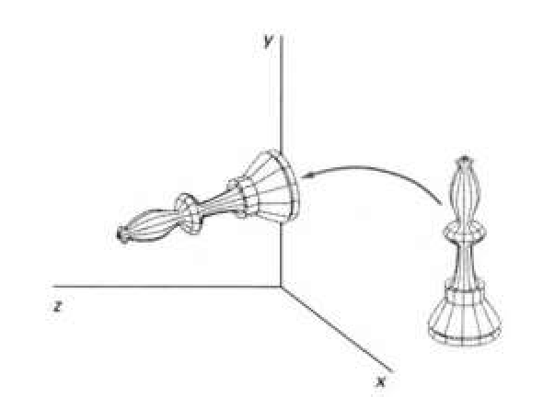
the equation for X-axis rotaion x’ = x
y’ = y cosθ – z sinθ z’ = y sinθ + z cosθ
⎡ x'⎤ ⎡1
0 0
cos θ − sin θ sin θ cos θ 0 0
0⎤ ⎡ x⎤
⎢ _{y'}⎥ ⎢₀
₀⎥ ⎢ _{y}⎥
⎢ ⎥ ₌ ⎢
⎥ ⋅ ⎢ ⎥
⎢ z'⎥ ⎢0
0⎥ ⎢ z ⎥
⎢ ₁ ⎥ ⎢₀
₁⎥ ⎢₁⎥
⎣ ⎦ ⎣
⎦ ⎣ ⎦

Slide 43


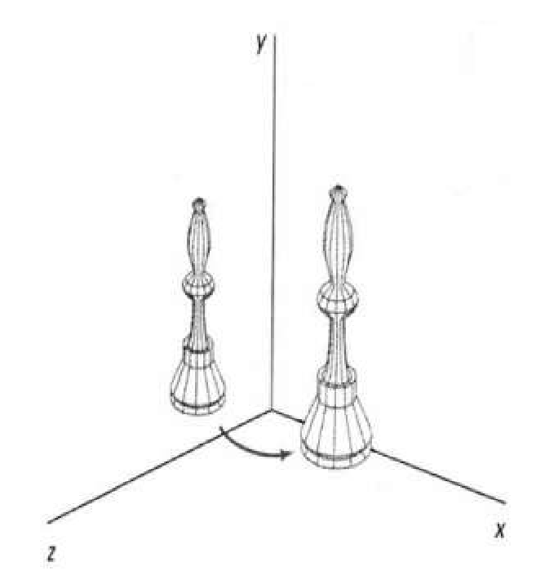
The equation for Y-axis rotaion x’ = x cosθ + z sinθ
y’ = y
z’ = z cosθ - x sinθ
⎡x'⎤ ⎡ cosθ 0 sin θ
1 0
0 cosθ 0 0
0⎤ ⎡x⎤
⎢ _{y'}⎥ ⎢
₀⎥ ⎢ _{y}⎥
0
⎢ ⎥ ₌ ⎢
⎥ ⋅ ⎢ ⎥
⎢ z'⎥ ⎢− sin θ
0⎥ ⎢ z ⎥
⎢ ₁ ⎥ ⎢
₁⎥ ⎢₁⎥
⎣ ⎦ ⎣
0
⎦ ⎣ ⎦

Slide 44


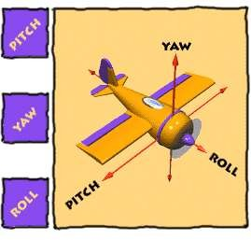
Pitch :- rotation Yaw:- rotation around the side to around the verti- side (about x-axis) cal axis(y-axis)
Roll:- Rotation around Front to back (Z-axis)

Slide 45

· Changes the size of the object and repositions
the object relative to the coordinate origin.
P ′ = S ⋅ P
⎡x′⎤
⎡s_{x} 0 0
s 0
0 s_{z}
0 0
0⎤ ⎡x⎤
⎢ _{y′}⎥ ⎢ ₀
₀⎥ ⎢ _{y}⎥
⎢ ⎥ ₌ ⎢
y
⎥ ⋅ ⎢ ⎥
⎢ z′⎥ ⎢ 0
0⎥ ⎢ z ⎥
⎢ ₁ ⎥ ⎢ ₀
₁⎥ ⎢₁⎥
⎣ ⎦ ⎣
⎦ ⎣ ⎦

Slide 46

· The equations for scaling
x’ = x . sx S_{sx,sy,sz} ➔ y’ = y . sy
z’ = z . sz
· The equations for scaling
x’ = x . sx
S_{sx,sy,sz} ➔ y’ = y . sy
z’ = z . sz

Slide 47


Reflection in computer graphics is used to emulate reflective objects like mirrors and shiny surfaces
Reflection may be an x-axis y-axis , z-axis. and also in
the planes xy-plane,yz-plane zx-plane.
Reflection relative to a given Axis are equivalent to 180 Degree rotations
, and

Slide 48


· Reflection about x-axis:-
· x’=x y’=-y z’=-z
· | 1 | 0 | 0 | 0
· | 0 | -1 | 0 | 0
· | 0 | 0 | -1 | 0
· | 0 | 0 | 0 | 1
Reflection about y-axis:- y’=y x’=-x z’=-z

Slide 49

· The matrix for reflection about y-axis:-
· | -1 | 0 | 0 | 0
· | 0 | 1 | 0 | 0
· | 0 | 0 | -1 | 0
· | 0 | 0 | 0 | 1
· Reflection about z-axis:-
· x’=-x | y’=-y | z’=z | -1 | 0 | 0 | 0
· |  |  | 0 | -1 | 0 | 0
· |  |  | 0 | 0 | 1 | 0
· |  |  | 0 | 0 | 0 | 1

Slide 50
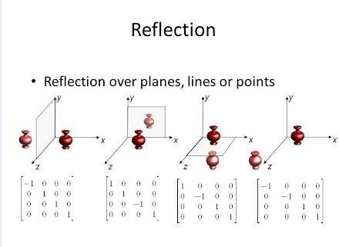

Slide 51

Modify object shapes
Useful for perspective projections
When an object is viewed from
different
directions and at different distances,
the
appearance of the object will be different. Such view is called perspective view. Perspective projections mimic what the human eyes see.
E.g. draw a cube (3D) on a screen (2D) Alter the values for x and y by an amount proportional to the distance from z_{ref}

Slide 53
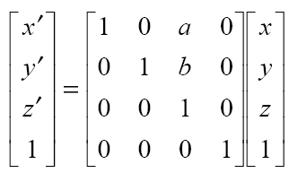
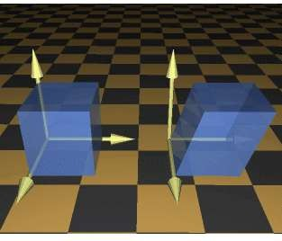
Matrix for 3d shearing
Where a and b can Be assigned any real Value.

